Slide 1
Introduction to the Ray Model

Slide 2
By the end of this lesson, you should be able to:
Define light as transverse waves of electromagnetic radiation.
Explain the ray model of light.

Slide 3

We’re all familiar with light: it comes from the Sun and other bright objects, and enables us to see the world around us.
Shadows, reflections, rainbows and all the colours we see when we look around come from the interaction of light with our environment.
In this module, we will use two models of light—the wave model and its derivative the ray model—to explain how light produces the effects we can see around us.

Slide 4
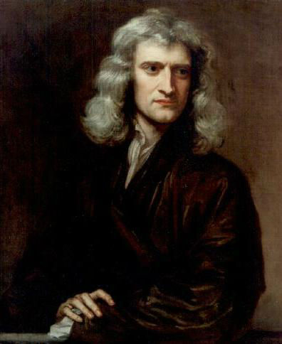
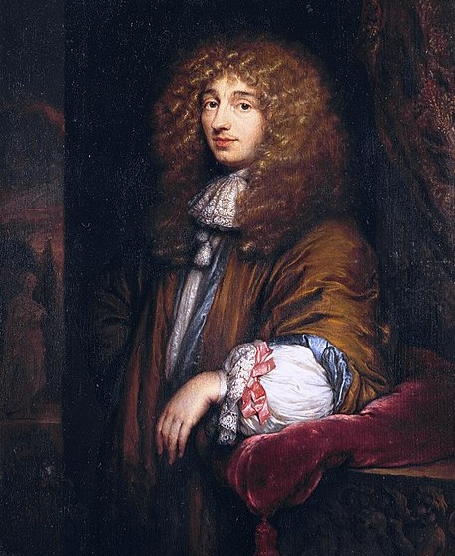
But what is light?
This simple question has caused much debate among scientists for thousands of years. Many ancient Greek philosophers believed we see through a beam emanating from the eye, but this view had many acknowledged problems even at the time. The Islamic scholar Ḥasan Ibn al-Haytham (أبو علي، الحسن بن الحسن بن الهيثم) proposed in around 1000 AD that we can see due to light that comes from the sun, rather than our eyes.
Much later, in the seventeenth century, Isaac Newton and Christiaan Huygens put forth two opposing theories of the nature of light. Newton believed that light was made up of tiny particles. Huygens thought it was a type of wave. Until the 19th century, Newton's theory was preferred; later, Huygens' gained popularity.

Slide 5
Modern theories state that light behaves as both a wave and a particle.
The wave model is used to explain how light propagates, and how it interacts with objects at macroscopic (visible to the naked eye) scales.
The particle model is used to explain how light interacts with materials on microscopic scales, when it is absorbed and emitted.
In this unit, we will be using the wave model of light. You'll soon see how it is related to the ray model.

Slide 6
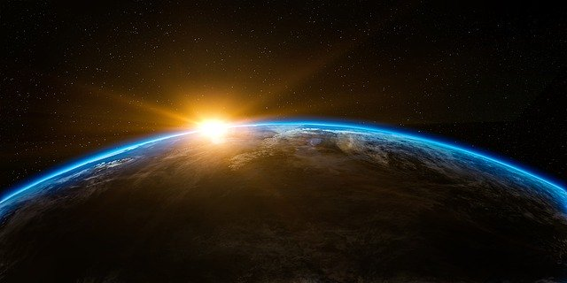
What kind of wave is light?
Scientists have determined from its properties that light behaves as a transverse wave. However, it can travel through a vacuum, so it is not a mechanical wave.
We also know, from a variety of experiments, that the speed of light in a vacuum (c) is 299792458m s⁻¹. For ease of calculation, we usually round this to 3.00×108m s⁻¹.

Slide 7
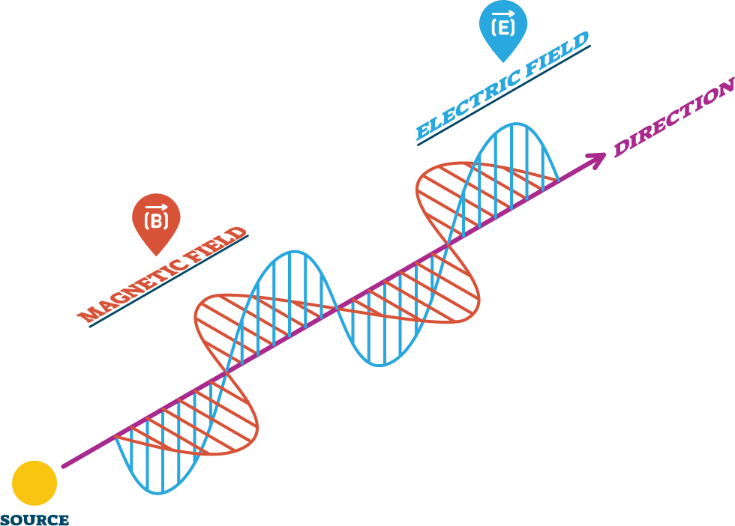
In 1864, James Clerk Maxwell developed a theory of electromagnetic radiation.
Electromagnetic radiation is energy that propagates through varying electric and magnetic fields. Both of these fields take the form of transverse waves, which travel together.
Their frequency and wavelength might vary, but they vary proportionally according to the equation c=fλ (where c is the speed of light, f is the frequency, and λ is the wavelength), so that the speed is always the same. And what speed did Maxwell calculate that they would have? 3×108m s⁻¹, the speed of light!

Slide 8
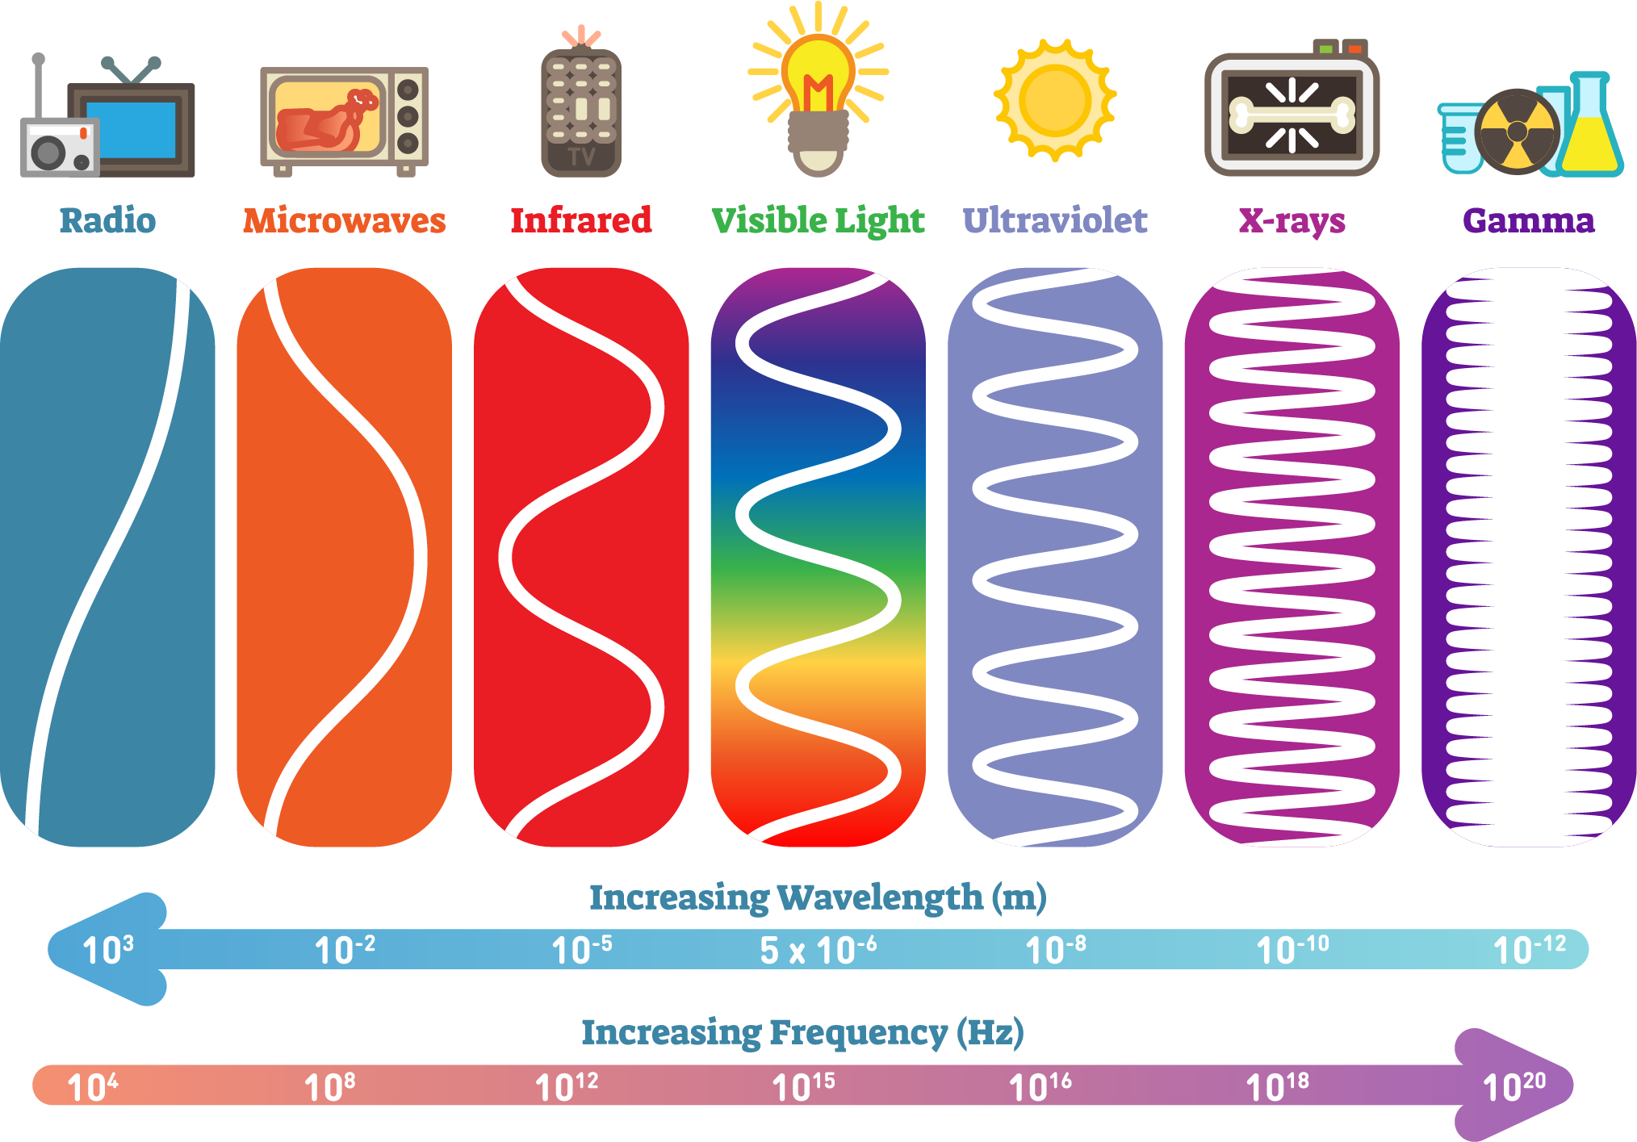
Variations in the frequency and wavelength of light change its properties.
The range of colours that we can see (the visible spectrum) correspond to a range of different wavelengths (and therefore frequencies) of light. Red light has the longest wavelength, and the wavelengths shorten through the rainbow to violet, with the shortest wavelength.
Visible light is just one small part of this electromagnetic spectrum, which also includes radio waves (longest wavelength, lowest frequency), microwaves, infrared, ultraviolet, X-rays and gamma rays (shortest wavelength, highest frequency).

Slide 9
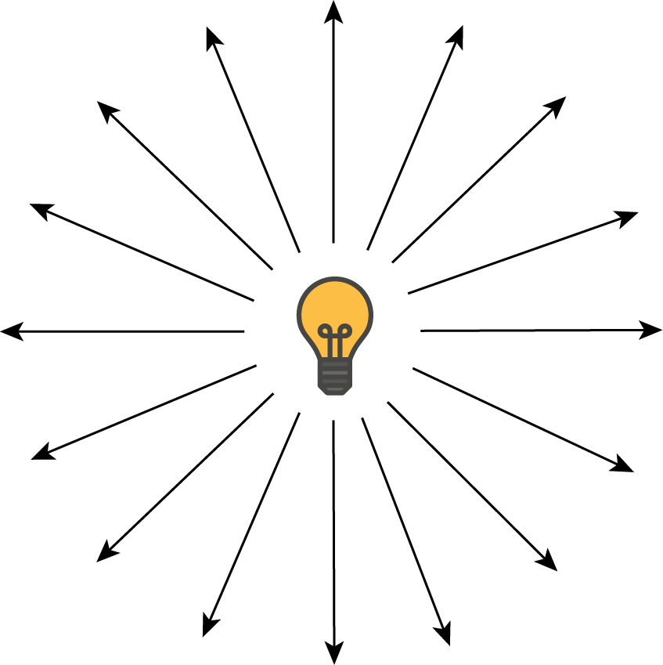
Light always travels radially outwards from a source.
This means that light is always made up of spherical wavefronts. To make diagrams easier to draw, we do not include the wavefronts, but only the rays. This is what we refer to as the ray model of light.

Slide 10
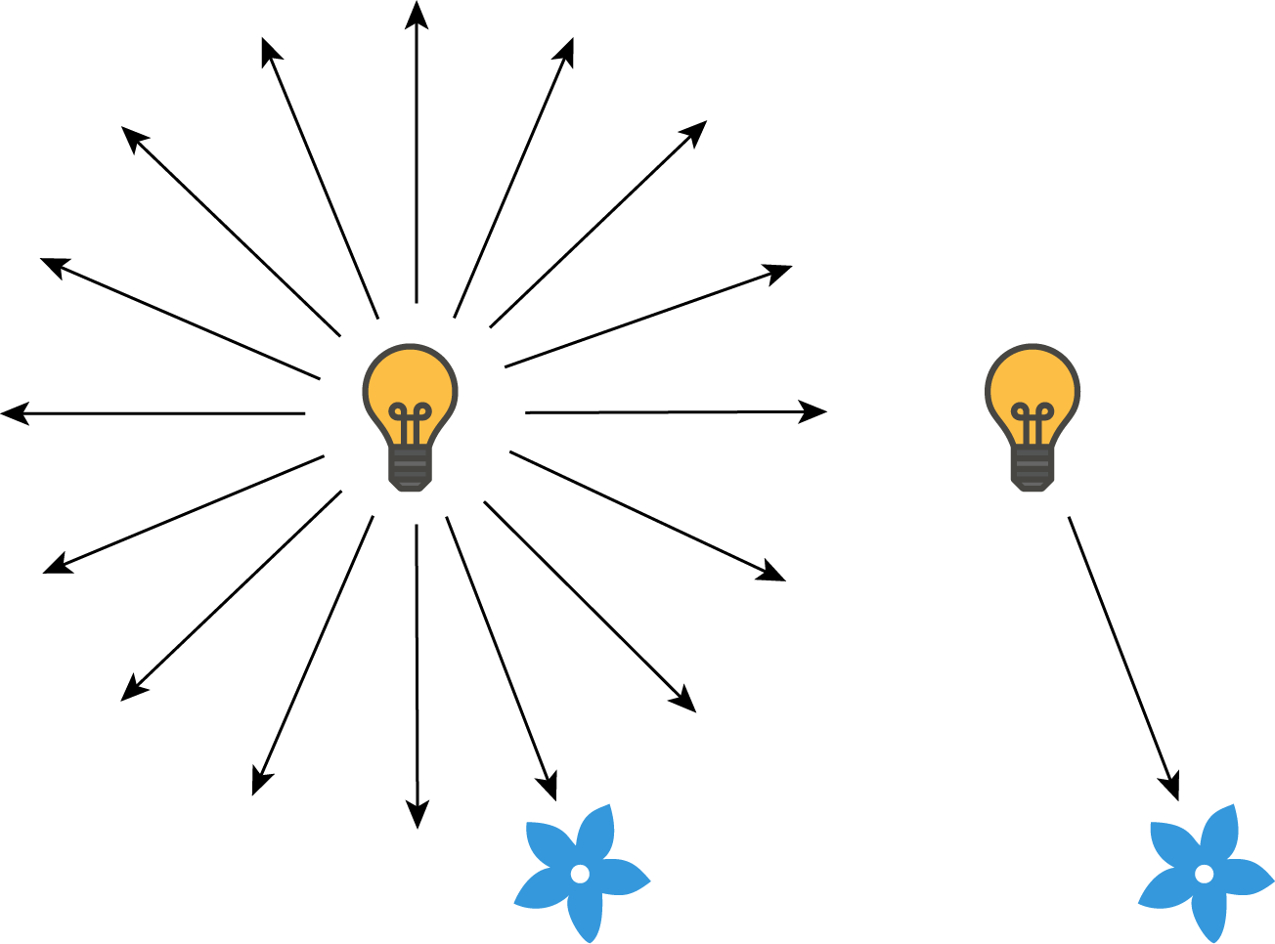
Rays make it easier to study the properties and movement of light.
A ray can be thought of as an infinitely narrow beam of light. Light rays from a source radiate (travel outwards) in all directions. However, it is only necessary to draw those rays that are relevant to the situation. This makes the ray model considerably simpler to work with.

Slide 11

By using the ray model, we can approximate light as travelling in straight lines.
When light travels from a very distant source, like the Sun, the circular wavefronts have to travel a long way and spread outwards very far. This means once they reach Earth, the parts of the wavefront we can see look flat (like looking at the horizon of the Earth). Flat wavefronts are referred to as plane waves, and plane waves travel in straight lines!
This makes sense when we think about the behaviour of light—for example, shadows go straight from the object casting them to the floor. Shadows from the Sun all point in the same direction. In this folder, we will assume the source of the light is distant enough that we can approximate it as travelling in straight lines.

Slide 12
The ray model is useful to explain interactions between light and objects that are much larger than the wavelength of light.
The range of wavelengths of visible light are about the same scale as the cells of bacteria (which range from around 200-1000 nanometres). The objects that we normally interact with are all much larger than this.
All the objects we can see light interacting with are much larger than the wavelength of light; this is why the ray model can be used. This does not necessarily hold true for wavelengths of light outside the visible spectrum.

Slide 13
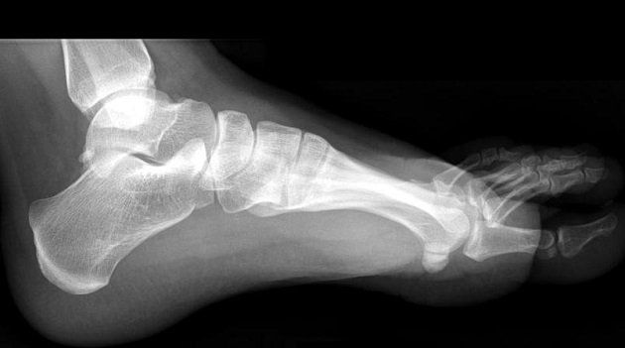
Light can interact with objects in various ways.
Light can be absorbed, transmitted or reflected by the atoms that make up an object. When visible light is transmitted through an object, we see that object as transparent. When it is reflected or absorbed, we see the object as opaque.
This changes at other wavelengths. For example, radio waves can pass through many solid objects, but they are reflected from the ionosphere in the Earth’s atmosphere. Human skin is opaque to visible light but transparent to X-rays; this is how X-ray imaging works.

Slide 14

The ray model of light is a scientific model.
It is used by scientists to explain phenomena, but it is not a completely accurate representation of the world. The ray model is very useful to model things such as reflection and refraction (which we will cover in later lessons). It is most useful when light interacts with objects much larger than its wavelength.
There are properties of light that the ray model cannot explain. It does not take account of variations in the wavelength of light, and in particular is ineffective at very short wavelengths. It is also best used when the source of light is distant so its path can be approximated by parallel straight lines.

